Slide 1

BEST LOCATION TO START RESTAURANT IN VISAKHAPATNAM
- VARUN SEKHARAMANTRI

Slide 2
INTRODUCTION
Visakhapatnam is the executive capital of the state, “Andhra Pradesh” in India. The city has a population of 17.3 lakhs as per the census 2011.Visakhapatnam is lovingly called as “Vizag” by its citizens.
The coastal city got diversified menu in almost all the restaurants. Sea foods being the specialty of the city, the type of dishes they offer cover the tastes right from North India to South India. So, when we are looking out to choose a right location for our restaurant the following aspects of a location are considered:
How accessible is the location?
How visible is the location?
Who are the competitors?
4. What are the places of interest around the location chosen (trending venues)?
5. Is there at least one restaurant in the neighborhood?

Slide 3
BUSINESS PROBLEM
The major objective of this project is to choose a location for the restaurant in the city, “Visakhapatnam” of “Andhra Pradesh” of “India” with assumptions that, the menu contains both North Indian and south Indian cuisine and the crime rate of the city is uniform and at undisturbedly levels.

Slide 4
APPROACH
First through foursquare API the list of restaurants and hotels are made.
Map of the district is to be shown after clustering.
Ratings of the hotels/restaurants are collected from Zomato website/dataset.
Ratings of every hotel in cluster are shown in bar graphs.
Nearby venues are also shown in the form of bar graphs.
Conclusions are given.

Slide 5
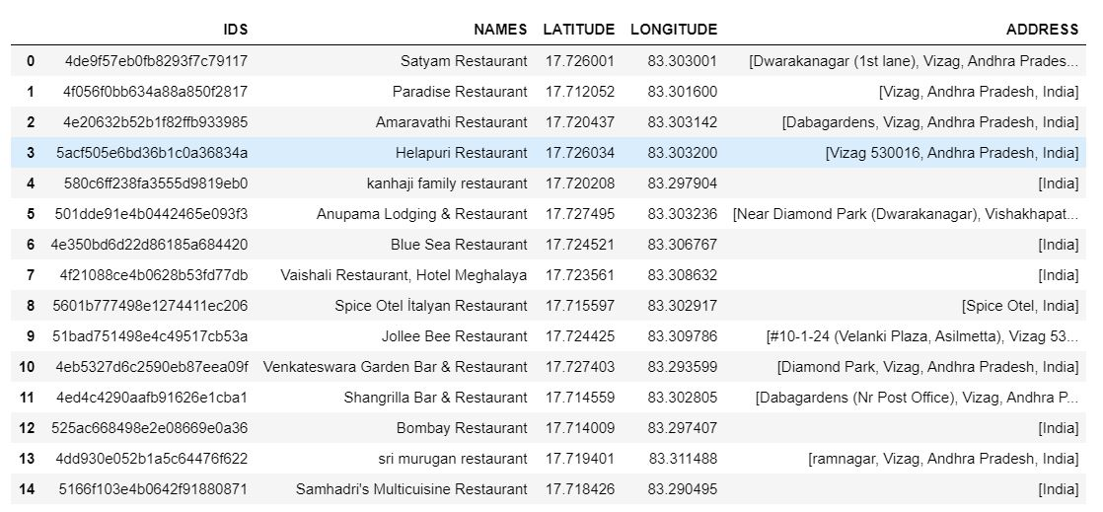
EXTRACTED AND CLEANED DATA

Slide 6
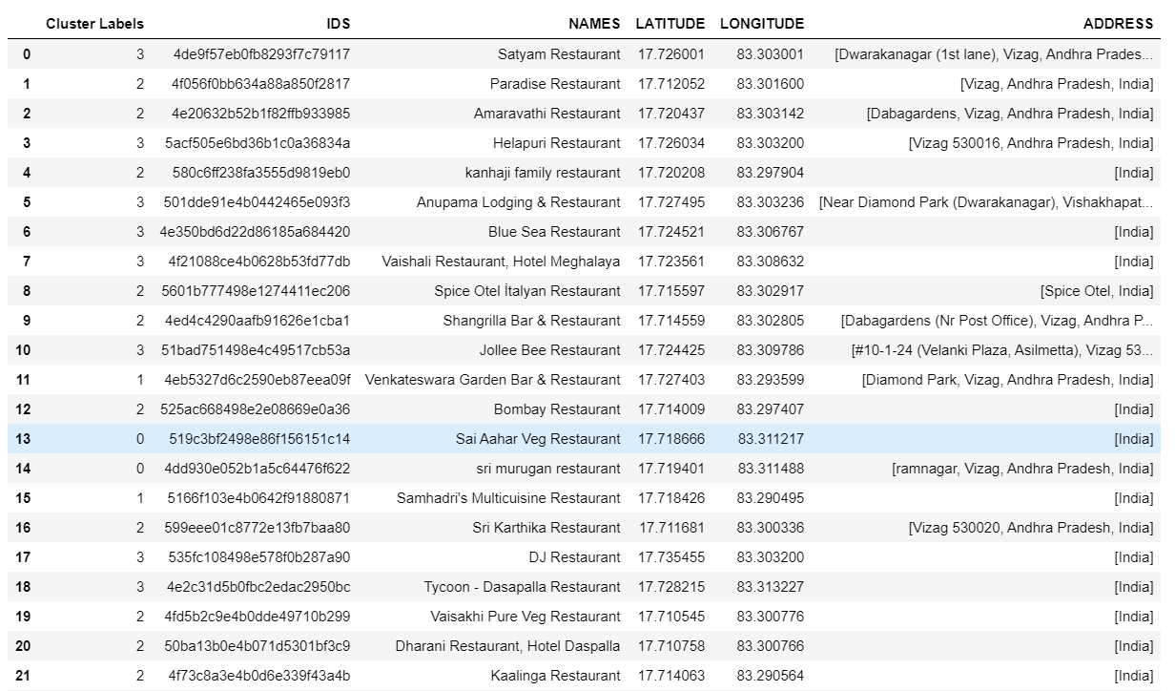
Clustered data

Slide 7
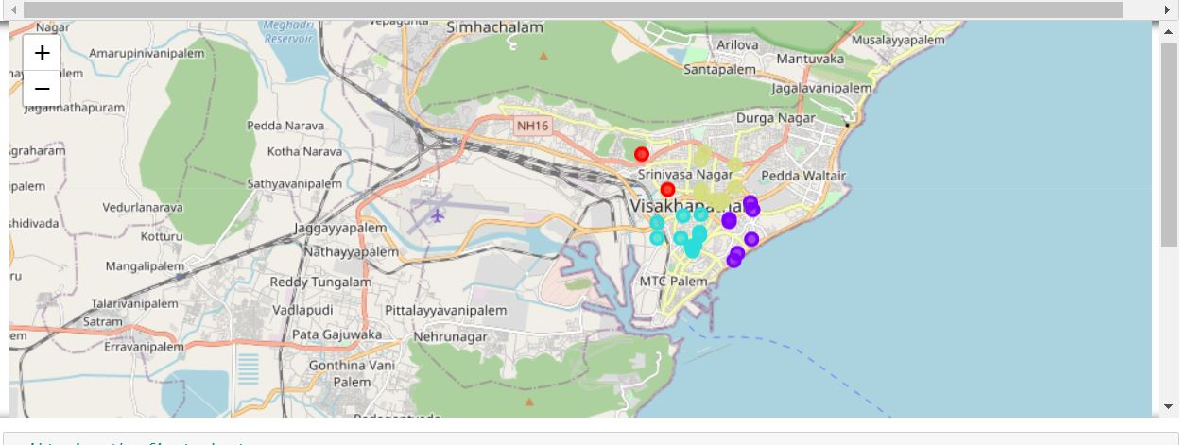
Map of clusters

Slide 8
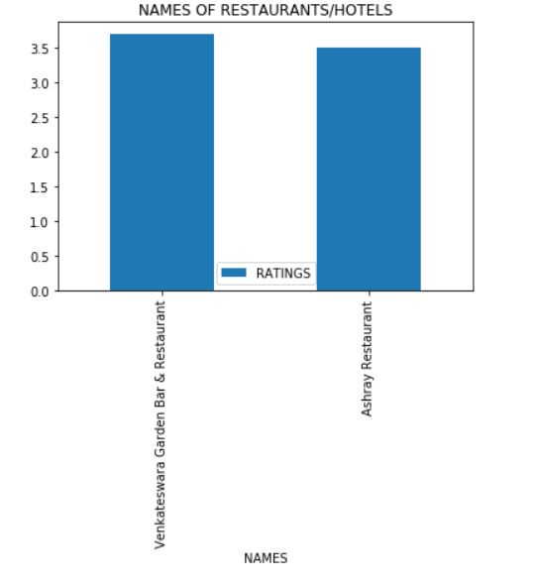
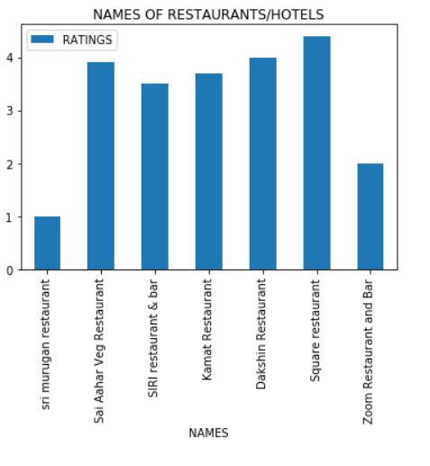
RATINGS VISUALIZATION CLUSTER WISE

Slide 9
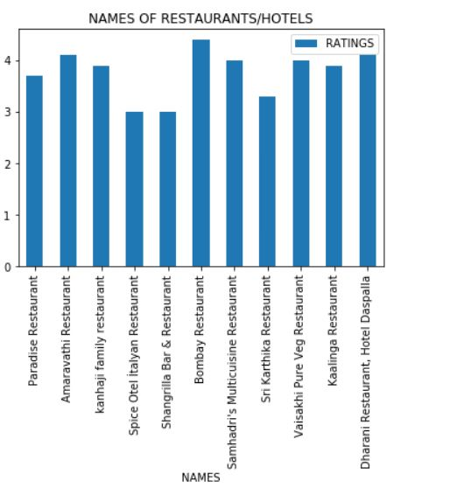
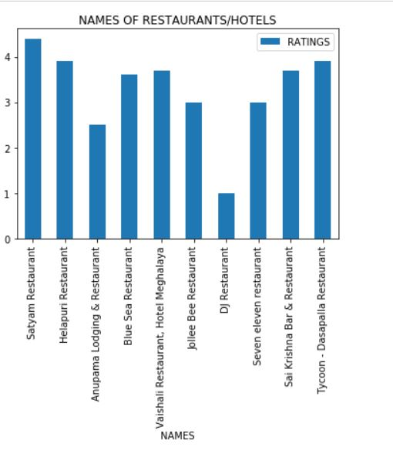

Slide 10
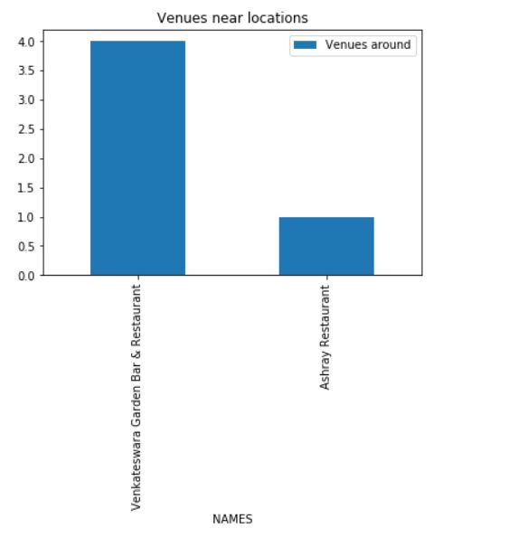
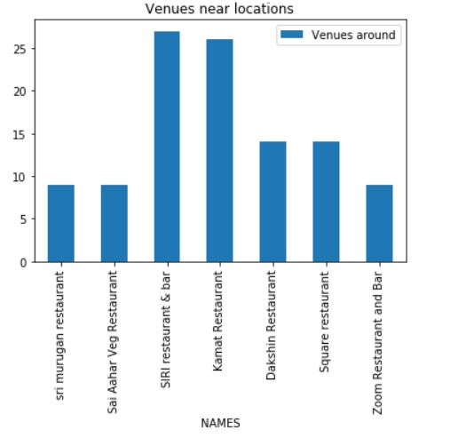
VENUES AROUND CLUSTER WISE

Slide 11
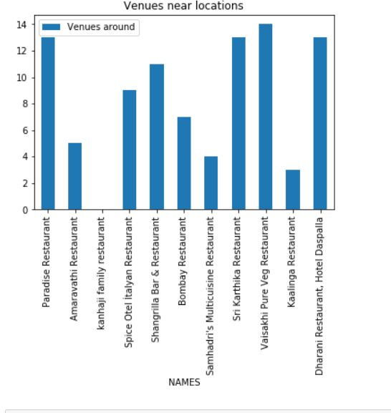
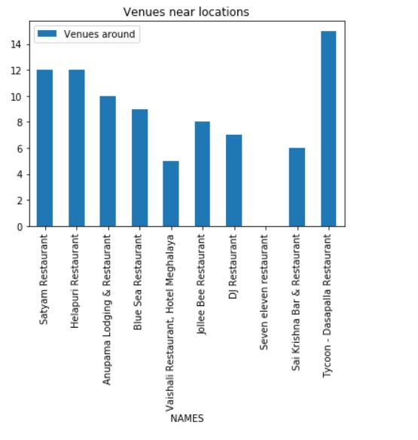
VENUES AROUND CLUSTER WISE

Slide 12
CONCLUSIONS
FIRST CLUSTER:
The "Venkateswara garden Bar & Restaurant" has the higher rating than "Ashray"(though it has fair enough rating).The number of venues are more near to "Venkateswara" rather than "Ashray".Hence it will be good if the restaurant is started near to "venkateswara" at a visible and accessible point. The locality in factually near DONDAPARTHY
SECOND CLUSTER:
The "Square Restaurant" has the higher rating when compared to all other restaurants in this cluster .Though all other restaurants has the fair ratings. Hotel sri murugan has poor rating ."SIRI restaurant and Bar" has the highest number of venues around. So, it is actually good idea to choose a place around SIRI restaurant or KAMAT because both the rating and venues are of fair number. The actual locality is near "siripuram".
THIRD CLUSTER:
The "Bombay Restaurant" has the higher rating when compared to all other restaurants in this cluster .Though all other restaurants has the fair ratings. Hotel spice otel and Shangrilla has lesser rating ."Vaisakhi pure veg" has the highest number of venues around.So, it is actually good idea to choose a place around Vaisakhi restaurant because both the rating and venues are of fair number. The actual locality is near "Jagadamba".
FOURTH CLUSTER:
The "Satyam Restaurant" has the higher rating when compared to all other restaurants in this cluster . Though all other restaurants has the fair ratings. Hotel seven eleven has poor rating . "Tycoon restaurant" has the highest number of venues around.So, it is actually good idea to choose a place around Satyam Restaurant restaurant because both the rating and venues are of fair number. The actual locality is near "Dwarakanagar".
Notes:
In Slide Show mode, select the arrows to visit links.

